Slide 1
MOSAIC MObile Stereo Access for In Car Stereo System
-lets you play the desired music
Team Number 2
Team Members Roll no
Shashank Mirji 18
Pooja Patil 26
Kumar Sugnani 58
Abhishek Raichur 59

Slide 2
Problem Definition
The universal wireless music transmitter app connecting to any fm receiver, which let’s you play the desired music present in your android smart phone.

Slide 3
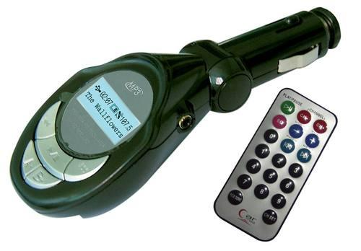
Abstract
Idea Generation
Used in cars for playing desired music. This device comes with a pen drive slot and/or an SD card slot

Slide 4
What makes this app a better one?
This app supports an hardware device which is capable of transmitting FM signals.
This let’s you play the music of your choice.
Provides desired level of flexibility and reliability.

Slide 5
What makes this app a better one?
Target audience – Students, Car owners etc
Commercial aspect – This app can be a free app initially but as it requires a hardware device, the app cannot be utilized for free.
Expected downloads – 500 during the initial phase. High downloads are expected in the subsequent phase.

Slide 6
Subject Relevance
Data structures – Stack , Queue, Linked List
Java programming
Data communication
Fundamentals of software engineering

Slide 7
Application Platform used and Domain
The platform used for this app is ANDROID
It is classified under the entertainment domain which stands on rank 1.

Slide 8
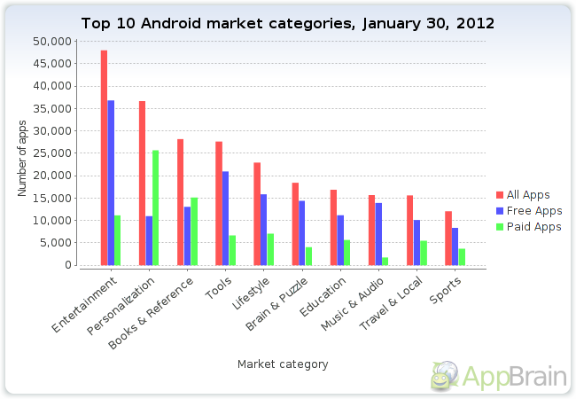

Slide 9
Hardware used
Fm transmitter
Hardware components
Register
Capacitor
Inductor
Transistor
Integrated circuit
Antenna

Slide 10
Q/A

Slide 11
Thank You

